Slide 1
Communication Skills
Module II
Section-III
Listening and speaking

Slide 2
Listening
Listening is the ability to accurately receive and interpret messages in the communication process.
Listening is key to all effective communication. Without the ability to listen effectively, messages are easily misunderstood. As a result, communication breaks down and the sender of the message can easily become frustrated or irritated.
If there is one communication skill you should aim to master, then listening is it.

Slide 3
Listening continues…
Good listening skills also have benefits in our personal lives, including:
A greater number of friends and social networks, improved self-esteem and confidence, higher grades at school and in academic work, and even better health and general well-being.
Studies have shown that, whereas speaking raises blood pressure, attentive listening can bring it down.
Listening is Not the Same as Hearing
Hearing refers to the sounds that enter your ears. It is a physical process that, provided you do not have any hearing problems, happens automatically.
Listening, however, requires more than that: it requires focus and concentrated effort, both mental and sometimes physical as well.
Listening means paying attention not only to the story, but how it is told, the use of language and voice, and how the other person uses his or her body. In other words, it means being aware of both verbal and non-verbal messages.
Listening is not a passive process. In fact, the listener can, and should, be at least as engaged in the process as the speaker. The phrase ‘active listening’ is used to describe this process of being fully involved.

Slide 4
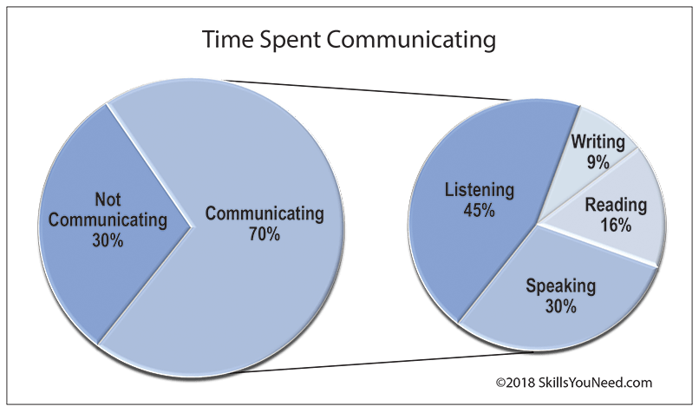
Listening continues…
Adults spend an average of 70% of their time engaged in some sort of communication.
Research shows that an average of 45% is spent listening compared to 30% speaking, 16% reading and 9% writing, a lot of time listening. It is worthwhile, taking a bit of extra time to ensure that you listen effectively.

Slide 5
Importance of Listening
There is no doubt that effective listening is an extremely important life skill.
Why is listening so important?
Listening serves a number of possible purposes, and the purpose of listening will depend on the situation and the nature of the communication.
To specifically focus on the messages being communicated, avoiding distractions and preconceptions.
To gain a full and accurate understanding into the speakers point of view and ideas.
To critically assess what is being said.
To observe the non-verbal signals accompanying what is being said to enhance understanding.
To show interest, concern and concentration.
To encourage the speaker to communicate fully, openly and honestly.
To develop an selflessness approach, putting the speaker first.
To arrive at a shared and agreed understanding and acceptance of both sides views.

Slide 6
Advantages of Listening
1. KEEPS YOU OUT OF TROUBLE
A good listener heeds instructions, suggestions, and warnings. People rarely have cause to get upset at someone who pays attention to them.
2. TELLS YOU WHAT’S GOING ON
Life is a total learning experience. Things are happening around you all the time, the more you hear and understand those things, the more you learn personally and professionally from your experience.
3. MAKES YOU MORE COMPETENT
The more information you have about your job, the more successfully you will perform it. Listening is the way to get more knowledge that most others have.
4. MAKES YOU LOOK INTELLIGENT.
That right not only does listening increase your intelligence, it makes you look intelligent. Consider the qualities you attribute to a person of few words. Stupidity is probably not one of them.
5. INCREASE YOUR POWER
“Knowledge Is Power” the saying goes. The power of knowledge gained through listening is that you have more data at your disposal than others. Your actions are well informed and appropriate.
6. HELPS YOU UNDERSTAND OTHERS.
Is there anything more important that understanding the needs, motivations and values of those around you? It is essential to know what it takes to get a subordinate or a superior to respond as you desire. What better way is there to learn what makes other people tick than to listen to them.
7. WINS RESPECT
How often have you heard another person say at least he listened to me? Couldn’t you feel the respect that had been earned by the person who really listened?

Slide 7
Advantages of Listening continue…
8. NEGOTIATES FOR YOU
The two keys to getting what you want from others are knowing what they are willing to give and what it will take to get them to give more. The only way to learn these is to listen, listen, listen
9. DEFUSES ANGER IN OTHERS
The best initial response to emotion is made with you ear. When we listen to an angry person, we come to understand the cause of the anger, we demonstrate our empathy, and we allow the venting that will ultimately make the person more rational. It is folly to attempt to reason with anger before we can understand it empathize with it and defuse it.
10. BUILDS SELF ESTEEM IN OTHERS.
When you stop what you are doing to listen to someone, you are saying, I value you and what you have to say. This is one of the surest ways to build self-esteem in subordinates, children, your spouse, and just about anyone else in your life.
11. BRING LOVE INTO YOUR LIFE
The most convincing expression of love and caring is to give the gift of listening . After all, who stops to listen to people they don’t like? Furthermore, one of the quickest ways to get people to think highly of you, if not love you, is to listen to them . Notice how children judge parental love by whether father and mother show an interest in them through listening.

Slide 8
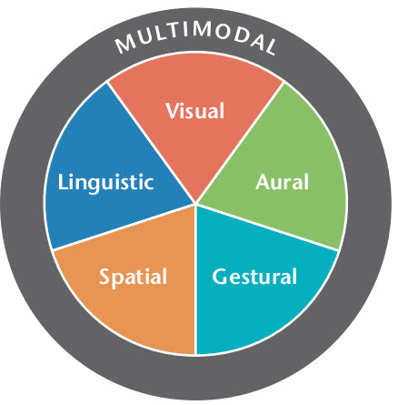
Modes of Expression

Slide 9
Modes of Expression continue….
Visual
The visual mode refers to the images and characters that people see.It is sometimes possible to find compositions that almost, if not completely, rely on a single mode. For instance, the “No Guns” symbol has no alphabetic text and no sound. Like many signs, it relies for its meaning on visual information. However, we might be able to say that the sign uses the spatial mode as well, since the gun appears behind the red bar that signals “no” or “not allowed.” So while the visual dominates in signs, even this composition is not “purely” visual.
Aural
The aural mode is focused on sound including, but not limited to, music, sound effects, ambient noises, silence, tone of voice in spoken language, volume of sound, emphasis, and accent. An example of an aural mode— one that depends almost exclusively on sound—might be the recording of a public speech that is delivered orally to a live audience, a radio address, or a podcast.
Gestural
The gestural mode refers to the way movement is interpreted. Facial expressions, hand gestures, body language, and interaction between people are all gestural modes. This has always been important in face-to-face conversations and in theater, but it has become more apparent on the web lately with the wide use of YouTube and other video players. The gestural mode works with linguistic, visual, aural, and sometimes even spatial modes in order to create more detail and communicate better to the reader or consumer of the gestural text.
Linguistic (or Alphabetic)
The linguistic mode refers to written or spoken words. The mode includes word choice, the delivery of written or spoken text, the organization of words into sentences and paragraphs, and the development and coherence of words and ideas. Linguistic is not always the most important mode; this depends on the other modes at play in the text, the type of text, and other factors. Linguistic is probably the most widely used mode because it can be both read and heard on both paper or audio. The linguistic mode is the best way to express details and lists.

Slide 10
Modes of Expression continue…
Spatial
The spatial mode, as the name implies, refers to the arrangement of elements in space. It involves the organization of items and the physical closeness between people and objects. A good example of the spatial mode might be the different ways in which chairs and desks are arranged in a classroom.Here is a “traditional” classroom: Individual desks are arranged in orderly rows, facing the front of the room to make the teacher who would stand before the chalkboard the center of attention. The teacher also stands at a distance from the students; the students who sit in the back could hardly even see the board. By contrast, in this advertisement for “collaborative classrooms,” we see the chairs and desks clustered in small groups so that students can work together on projects. The classroom is also de-centered, which suggests that the teacher and students are working together as partners rather than in a hierarchical manner.

Slide 11
Speaking
conversations
The goal of a conversation is for two persons.
The person you are talking with will having a conversation, such as your friend, parent, or teacher.
To share your thoughts and ideas with each other. To have a successful conversation, you must understand the language of your conversational partner and produce language that your conversational partner can understand. This is not easy! You must make sure you talk and listen at the right times. You must think of all the words, sounds, and sentences you want to say, while listening to what your partner says. You must also choose words, sounds, and sentences that you think your partner can understand. One thing people do to make this easier is to copy the language that their conversational partner has already used in the conversation. This is called alignment.
When people in a conversation copy elements of each other’s language to make it easier to understand each other.
it is a behavior commonly used by humans to make conversations easier and more successful.
Types of Alignment
Alignment occurs when someone re-uses any aspect of language that their conversational partner has recently used in the conversation. Alignment happens all the time: You have probably used alignment in conversations without even noticing! Alignment is particularly useful when a conversation becomes a bit tricky to understand. There are at least three types of alignment

Slide 12
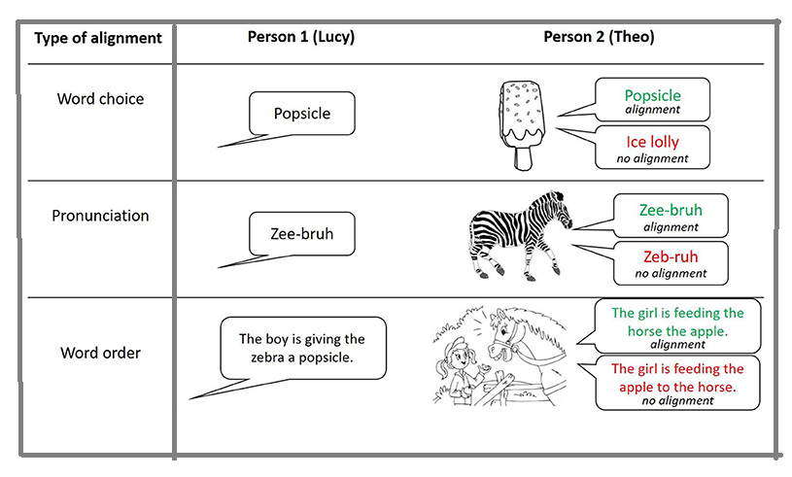

Slide 13
Types of alignment continue….
Alignment of Word Choice
Let us imagine that two friends, Theo and Lucy, are from two different English-speaking countries: Lucy is from the United States of America (USA) and Theo is from the United Kingdom (UK). In these two countries, people sometimes use different words to mean the same thing, such as saying “popsicle” (USA) or “ice lolly” (UK). If Lucy uses the word “popsicle” in a conversation, this may sound odd to Theo because he would normally say “ice lolly,” but he might still know what Lucy means because he has heard it in movies. When it is Theo’s turn to talk, Theo may choose to say the word “popsicle,” even though this is not the word he would normally use, because he wants to make sure that Lucy understands him. This is word choice alignment, which is also sometimes called lexical allignment.Theo is adapting which words he uses to increase the likelihood of having a successful conversation with Lucy.
Alignment of Pronunciation
In addition to copying each other’s word choices, Theo and Lucy may start copying each other’s pronunciation. For example, if Lucy pronounces the word zebra with an American pronunciation
(“zee-bruh”), Theo may pronounce it the same way when speaking with Lucy, even though he would usually say it with a British pronunciation (“zeb-ruh”).
Alignment of Word Order
Lucy and Theo may also copy each other’s word orders. For example, if Lucy says, “The boy is giving the zebra a popsicle,” Theo may use the same word order when speaking next. He might say “The girl is feeding the horse the apple,” even though he could use a different word order to say the same thing: “The girl is feeding the apple to the horse.”
When you are talking with your friends, it is likely that you use some, if not all, of these types of alignment. Using alignment is a very easy way to make conversations easier and communication more successful. This copying behavior also helps speakers produce language faster, which can be important for keeping the conversation flowing. Alignment can be something speakers decide to do, or they can do it without knowing they are doing it. We said previously that Theo could choose to use the word “popsicle” to help Lucy understand him. However, if he frequently talks with Lucy, Theo may start using the word “popsicle” more often than “ice lolly,” without realizing he is doing it.

Slide 14
Methods of asking questions
1. Open-Ended Questions:
Definition: Open-ended questions are designed to elicit detailed and comprehensive responses.
Example: "Can you elaborate on your research methodology and its implications for the study?“
2. Closed-Ended Questions:
Definition: Closed-ended questions typically require specific answer, often a "yes" or "no."
Example: "Did you use quantitative or qualitative research methods in your study?"
3. Probing Questions:
Definition: Probing questions are used to explore deeper into a topic or response.
Example: "Could you provide more details on the challenges you faced during the data collection process?"
4. Leading Questions:
Definition: Leading questions guide the respondent toward a particular answer or perspective.
Example: "Do you agree that implementing these changes would improve the overall efficiency of the project?"
5. Clarifying Questions:
Definition: Clarifying questions seek to ensure a clear understanding of information provided.
Example: "I want to make sure I understand correctly, could you clarify your stance on the proposed solution?"
6. Reflective Questions:
Definition: Reflective questions encourage individuals to think critically about their experiences or opinions.
Example: "How do you think your background and experiences have influenced your approach to this research?"
7. Socratic Questions:
Definition: Socratic questions challenge assumptions and stimulate critical thinking.
Example: "What underlying assumptions did you consider when formulating your hypothesis?"
8. Hypothetical Questions:
Definition: Hypothetical questions explore potential scenarios or future possibilities.
Example: "If you were to conduct this research again, what changes or improvements would you make?"
9. Nonverbal Questions:
Definition: Nonverbal cues such as facial expressions and body language can be used as subtle questions.
Example: Nodding or raising an eyebrow to prompt elaboration on a particular point.

Slide 15
Brain Storming
Brainstorming
One of the best ways to help solidify your speech topic is to brainstorm. You can brainstorm by yourself, or you might want to bring in a few friends, colleagues, or classmates to help you come up with ideas in a group setting. You can brainstorm using a number of different exercises.
Word Association
Start with a broad topic idea. What words, topics, or other subjects do you associate with that first topic? Now what words, topics, or other subjects do you associate with the following word? Continue this chain of word association to give you a broad spectrum of ideas.
Clustering
Also known as mind-mapping, clustering gives your word association a visual form. Start with your main idea and draw a circle around it, thinking of it as the hub of a wheel. Now, begin to write other associated ideas, topics, or subcategories related to that main topic around the hub, and connect them as separate spokes. From each spoke, begin to jot down other associated ideas and thoughts. As your cluster begins to grow, you might want to connect smaller spokes to one another and create new links between subjects.
Free writing
This is probably the simplest brainstorming method of all. Set a timer and begin writing whatever thoughts or ideas come to mind about your particular subject. You might find it easier to type your freewriting instead of writing it by hand, so you can keep up with your thoughts faster. Whatever you do, don’t stop writing.
Another way of free writing is to record yourself talking for a set period of time and then transcribe your key points to go back to and clarify later. Once your time is up, go back and highlight or circle relevant points or topics that stick out for you. You’ll refine these later.
Distill Your Ideas into One Topic
Once you’ve brainstormed your many ideas, it’s time to refine your ideas and distill them into one topic. Look for themes, patterns, and commonalities when going through your brainstorming notes. Use these themes to help guide you toward a singular topic.
Do a Little Homework
While you will definitely research your topic, you might want to do some “pre-search” – that is, a little research before the real research. Do a quick scan to see what others have said or written about your topic. This might give you even more ideas on how to refine and distill your topic, or more appropriately adapt it to your audience or venue.

Slide 16
Presenting speech Reports
An oral report is a speech that communicates information, while a visual report includes the use of visuals to communicate information. When delivered by a speaker, presentations become both oral and visual reports. Presentation software—such as Google Slides or Microsoft PowerPoint—supports a speech by helping the speaker with visual access to their ideas.
Preparation
Creating and organizing a presentation should begin by outlining these three components:
Introduction
The introduction of a presentation provides listeners with a clear objective as to the purpose of the speech. The introduction serves as a vehicle for sharing the main idea, with the foreshadowing of specific topics to come. An important piece to introducing a presentation topic is to fully engage the audience. Some presentations begin with humor—information designed to be comical or amusing—for this reason. An appropriate joke or anecdote can help ground the presentation in realism and grab the audience's attention immediately.
Body
The body of a presentation includes the supporting points for the specific topic being discussed. If you have gathered primary and secondary sources, the body is the place in a presentation in which you can share that data. The body also consists of fact and opinion statements. Factual statements provide information free from personal belief. For example, a statistic is an example of a fact. Opinion refers to personal beliefs you hold. A presenter must be clear on if he or she is presenting facts or opinions.
Conclusion
The final part of a presentation is the conclusion. Like the introduction, the conclusion should be interesting for listeners. It provides another instance where appropriate humor or anecdotes can liven the presentation. The primary function of a conclusion is to restate the main idea for listeners and to leave them with a powerful closing remark. The end of a presentation is also the most common time in which audience questions may be answered. Designate a time at the completion of your presentation to engage the audience in discussion.

Slide 17
Presenting speech Reports
Using Visuals in Presentations
Visuals such as graphics, charts, and figures are a great way to increase the impact of your message and increase audience understanding of what you are trying to explain. For example, a sales report would benefit from the inclusion of visual charts showing last quarter's sales data. However, it is important not to overuse visual elements. Including multiple videos and animation may be too much of a distraction for a short presentation. Focus on selecting visual aids that will support the main purpose of the presentation and complement your message. If a visual or audio aid could be potentially distracting, it is best to leave it out.
Presenting Visual and Oral Reports
Delivering planned speeches with confidence becomes easier when you have fully prepared and practiced your use of voice and body language beforehand. If you are presenting with a visual aid such as a slide show, you should never read verbatim from your presentation, but rather clarify or build upon the points listed.
As you prepare to present your visual or oral report, keep these tips in mind:
Before the presentation, record yourself presenting so that you can self-evaluate how you sound.
Consider your volume—you should not be speaking too loudly or too quietly.
Your rate of speaking should not be too fast. Speak at a calculated pace so that listeners understand what you are saying.
Avoid empty words such as "um" and "like."
Control your pitch, which is the highness or lowness of a sound. Some people change pitches out of nervousness, making it important to be aware of your presenting style so that you can best control the pitch of your voice.
Control your pitch, which is the highness or lowness of a sound. Some people change pitches out of nervousness, making it important to be aware of your presenting style so that you can best control the pitch of your voice.
Make sure you correctly pronounce and enunciate each word.
Be aware of your body language. For instance, a presenter who fidgets, avoids eye contact, and stands with his arms crossed sends messages of nervousness and a lack of confidence. Good posture and eye contact will help ensure your body language appears confident.
Dress appropriately.

Slide 18
Improving speech Delivery
1. Voice Modulation:
Variation in tone, pitch, and volume adds depth and interest to speech delivery.
Practice modulating your voice to emphasize key points, convey emotions, and maintain audience engagement.
2. Articulation and Pronunciation:
Clear articulation and correct pronunciation improve the intelligibility of speech.
Practice enunciating words carefully and accurately, paying attention to consonant and vowel sounds.
3. Pace and Pausing:
Varying the pace of speech and incorporating strategic pauses enhances comprehension and emphasizes important points.
Avoid speaking too quickly or too slowly, and use pauses to allow the audience to digest information and reflect on key ideas.
4. Body Language:
Nonverbal cues such as gestures, facial expressions, and posture play a significant role in speech delivery.
Maintain good posture, use gestures purposefully to emphasize points, and maintain eye contact with the audience to establish rapport.
5. Confidence and Presence:
Confidence in delivery contributes to the persuasiveness and credibility of the speaker.
Practice speaking with confidence, maintain a positive demeanor, and project enthusiasm for the topic to engage the audience effectively.

Slide 19
Improving speech Delivery
6. Audience Awareness:
Tailoring speech delivery to the audience's preferences, interests, and knowledge level enhances engagement and receptiveness.
Adapt your tone, language, and examples to resonate with the audience, and anticipate potential questions or concerns.
7. Visual Aids and Props:
Visual aids such as slides, charts, and props can complement speech delivery and reinforce key points.
Use visual aids sparingly, ensure they are clear and relevant, and maintain focus on the audience rather than the slides.
8. Rehearsal and Feedback:
Practicing speech delivery multiple times improves fluency, confidence, and overall effectiveness.
Seek feedback from peers, mentors, or communication experts to identify areas for improvement and refine your delivery style.
9. Authenticity and Passion:
Authenticity and genuine passion for the topic enhance the speaker's connection with the audience and make the speech more compelling.
Speak from the heart, share personal insights or experiences when relevant, and convey enthusiasm to inspire and motivate the audience.

Slide 20
Expressing techniques
Expressing oneself effectively while speaking is a key aspect of communication skills. Whether in academic presentations, professional settings, or everyday conversations, mastering various techniques enhances clarity, engagement, and the overall impact of the message. Postgraduate students can benefit from understanding and practicing these expressing techniques to become more confident and articulate speakers.
1. Clarity of Thought:
Clearly organize and structure your thoughts before speaking.
Use concise and straightforward language to convey ideas.
2. Active Listening:
Actively listen to others to ensure a relevant and responsive contribution to the conversation.
Paraphrase or summarize others' points to demonstrate understanding.
3. Vocabulary and Language Use:
Choose words carefully to convey precise meanings.
Adapt your language to the audience, avoiding jargon or overly complex terms when unnecessary.
4. Emphasis and Intonation:
Use emphasis and varied intonation to highlight key points and maintain listener engagement.
Experiment with pitch and tone to convey emotions or importance.
5. Body Language:
Leverage nonverbal cues such as facial expressions, gestures, and posture to complement verbal communication.
Align your body language with the message to enhance authenticity.

Slide 21
Expressing techniques continue….
6. Pauses and Silence:
Employ strategic pauses to allow the audience to absorb information and emphasize key points.
Embrace silence when appropriate, allowing time for reflection or response.
7. Storytelling:
Use storytelling techniques to make your message more relatable and memorable.
Incorporate anecdotes, examples, or case studies to illustrate key concepts.
8. Visual Imagery:
Paint mental pictures with your words to create vivid imagery for the audience.
Use descriptive language to enhance understanding and engagement.
9. Adaptability:
Be adaptable in your communication style based on the context and audience.
Adjust your pace, tone, and level of formality to suit the situation.
10. Empathy:
Demonstrate empathy by considering the perspectives and feelings of your audience.
Acknowledge and validate others' viewpoints, fostering a positive and open communication environment.
11. Authenticity:
Be genuine and authentic in your expression.
Share personal experiences or insights when relevant to establish a connection with the audience.

